Slide 1
Grid Data Handling from Grib File using Pygrib
ACTIVITY

Slide 2
Activity
Given the GRIB file in
/home/nms/DATA/sample_grib/E1E11111200111200001
What is the initial date and time of this file?
What is the forecast hour? Valid date and time?
How many GRIB messages are there in the file?

Slide 3
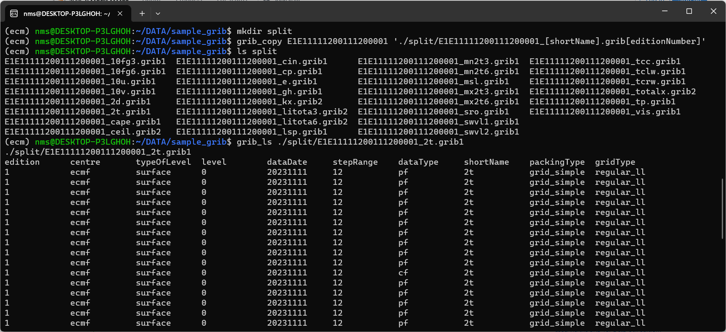
ecCodes | grib_copy | split file by parameter

Slide 4
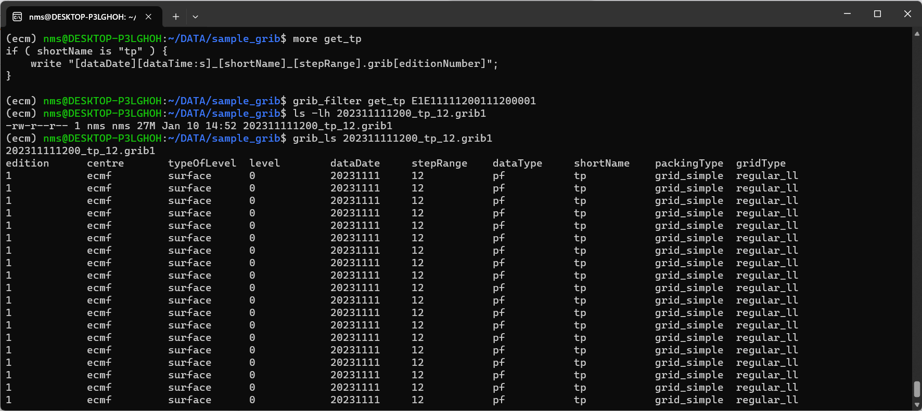
ecCodes | grib_filter | subset a variable

